Slide 1
City of Merced Introduction to Redistricting
Dr. Jeff Tilton, Senior Consultant
National Demographics Corporation

Slide 2
Public Hearing 1 of 4
TONIGHT
Redistricting Process
Rules and Goals
Neighborhoods/Communities of Interest
Mapping Tools
Advisory Commission?
Council Direction

Slide 3
Redistricting Process
Step | Description
Two Initial Hearings June 21 & August 2 | Held prior to release of draft maps. Education and to solicit input on the communities in the Districts.
Census Data Release Mid/Late August | Census Bureau releases official 2020 Census population data.
California Data Release Early October 2021 | California Statewide Database releases California’s official ‘prisoner-adjusted’ 2020 redistricting data.
Public Workshops January 22 | Two separate mapping tools workshops – morning and afternoon. (Additional workshops, based on demand.)
Two Draft Map Hearings February 7 & March 7 | Two Public Hearings to discuss and revise the draft maps and to discuss the election sequence.
Map Adoption By April 17, 2022 | Final map must be posted at least 7 days prior to adoption. Map adopted via ordinance.*
*SB 594 would explicitly confirm that the county can adopt maps by resolution.

Slide 4
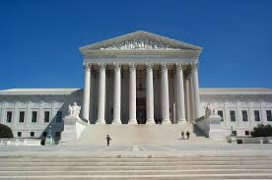
Redistricting Rules and Goals
1. Federal Laws
2. California Criteria for Cities
3. Other Traditional Redistricting Principles
Equal Population
Federal Voting Rights Act
No Racial Gerrymandering
Geographically contiguous
Undivided neighborhoods and “communities of interest” (Socio-economic geographic areas that should be kept together)
Easily identifiable boundaries
Compact (Do not bypass one group of people to get to a more distant group of people)
Prohibited:
“Shall not favor or discriminate against a political party.”
Minimize voters shifted to different election years
Respect voters’ choices / continuity in office
Future population growth
Preserving the core of existing districts

Slide 5
Defining Neighborhoods
1st Question: What is your neighborhood?
2nd Question: What are its geographic boundaries?
Examples of physical features defining a neighborhood boundary:
Natural neighborhood dividing lines, such as highway or major roads, rivers, canals and/or hills
Areas around parks or schools
Other neighborhood landmarks
In the absence of public testimony, planning records and other similar documents may provide definition.

Slide 6
Beyond Neighborhoods: Defining Communities of Interest
1st Question: What defines your community?
Geographic Area, plus
Shared issue or characteristic
Shared social or economic interest
Impacted by county policies
Tell us “your community’s story”
2nd Question: Would this community benefit from being “included within a single district for purposes of its effective and fair representation”?
Or would it benefit more from having multiple representatives?
Definitions of Communities of Interest may not include relationships with political parties, incumbents, or political candidates.

Slide 7
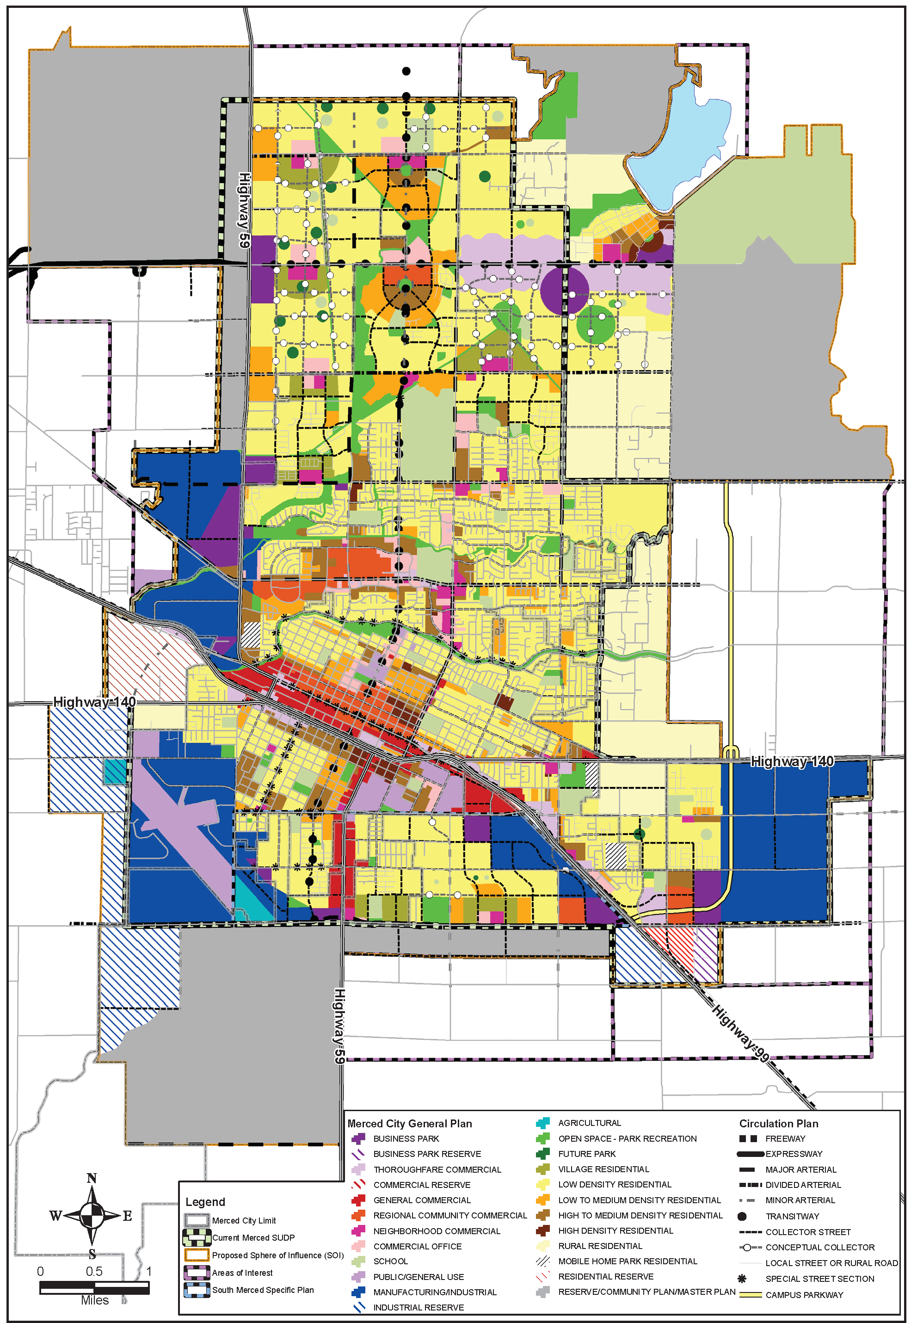
Possible Neighborhoods / Communities

Slide 8
Beyond Neighborhoods: Communities
Under the California Elections Code, “community of interest” has a very specific definition in the context of districting and redistricting cities and counties:
A “community of interest” is a population that shares common social or economic interests that should be included within a single district for purposes of its effective and fair representation.
Communities of interest do not include relationships with political parties, incumbents, or political candidates.
(emphasis added)

Slide 9
Public Mapping and Map Review Tools
Different tools for different purposes
Different tools for different levels of technical skill and interest
Simple “review draft maps” tool
Easy-to-use “Draw your neighborhood” tool
Paper- and Excel-based simple “Draw a draft map” tools
Powerful, data-rich “Draw a draft map” tool
Whether you use the powerful (but complicated) online mapping tool, Excel, the paper kit, or just draw on a napkin, we welcome your maps!

Slide 10
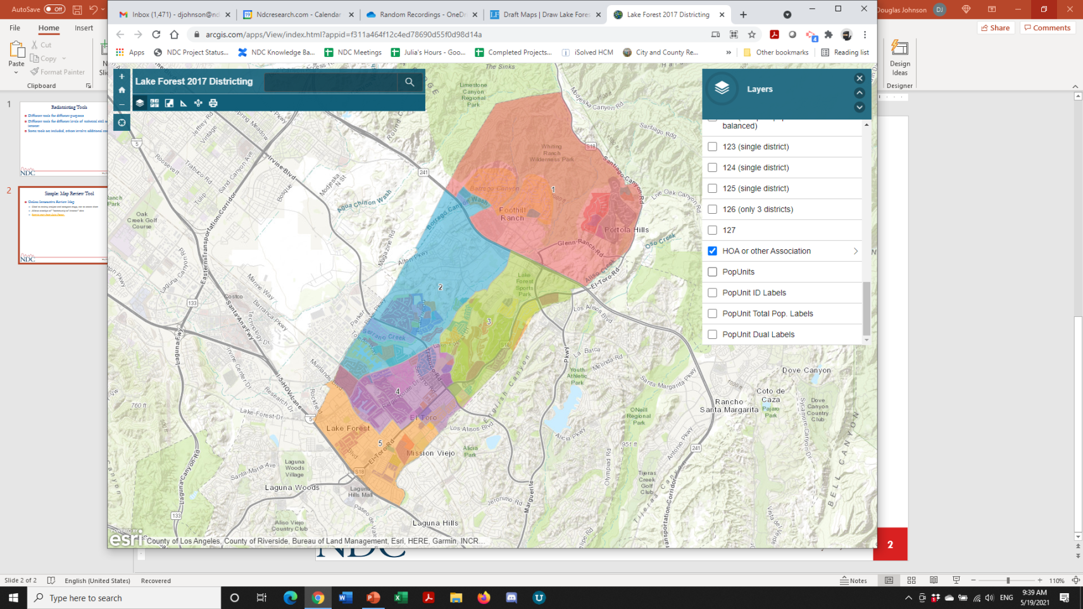
Simple Map Review Tool
Online Interactive Review Map
ESRI’s “ArcGIS Online” – similar to Google Maps in ease of use
Used to review, analyze and compare maps, not to create them
Includes overlays of “community of interest” and other data

Slide 11
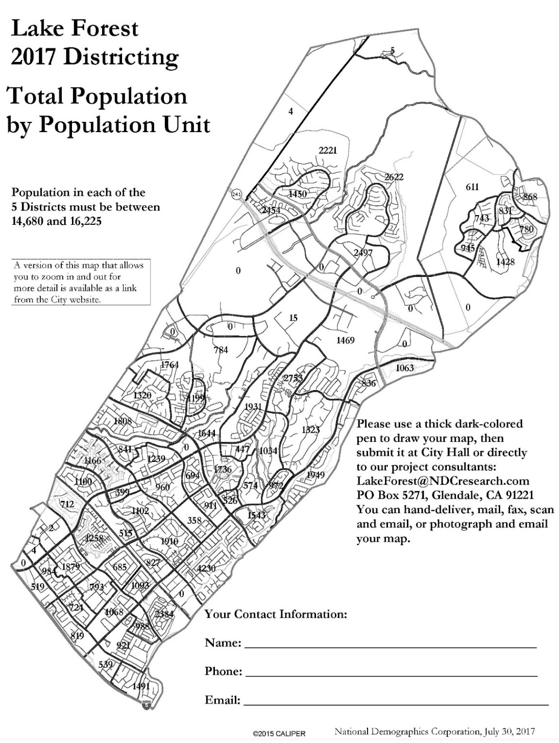
Simple Map Drawing Tool
Paper “Public Participation Kit”
For those without internet access or who prefer paper
Total Population Counts only – no demographic numbers

Slide 12
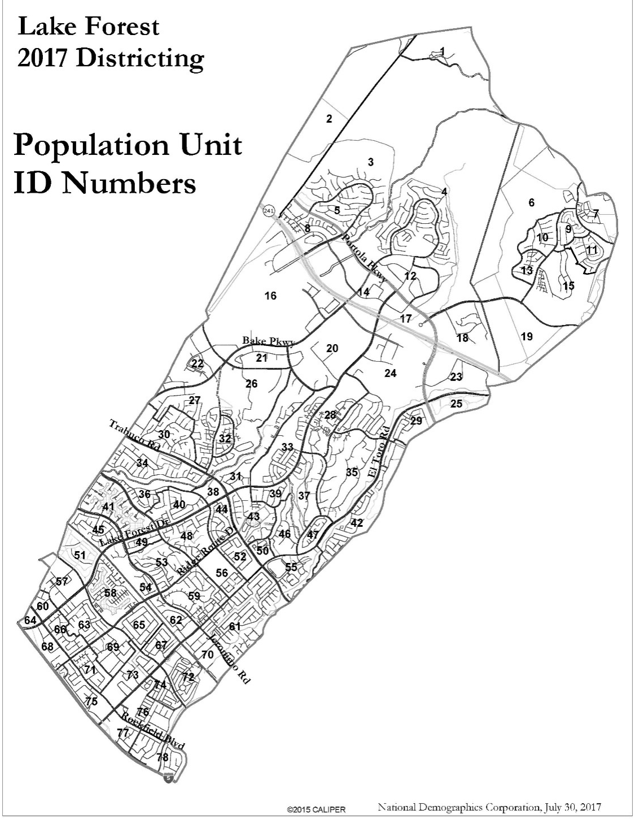
Simple Map Drawing Tool + Excel Supplement
“Public Participation Kit”
For those who know Excel and do not wish to use online tools
Adds CVAP data
Excel does the math

Slide 13
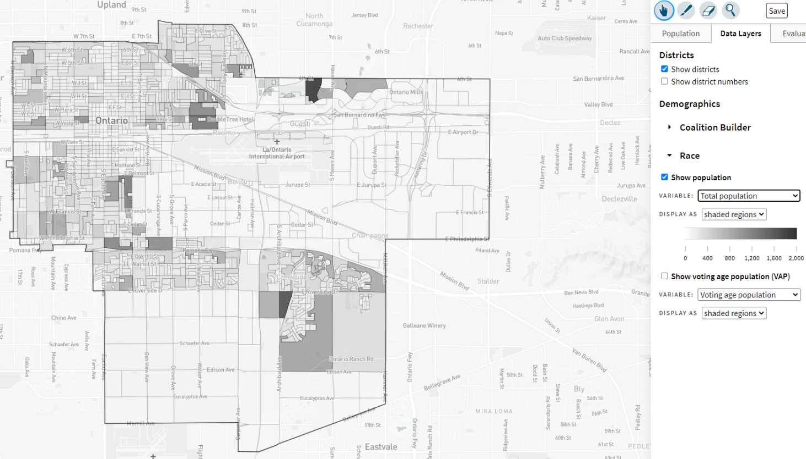
DistrictR
“Draw Your Community of Interest” focus
Also includes simple district-mapping tool
Only available in English
Similar external options: Representable.org, DrawMyCACommunity.org

Slide 14
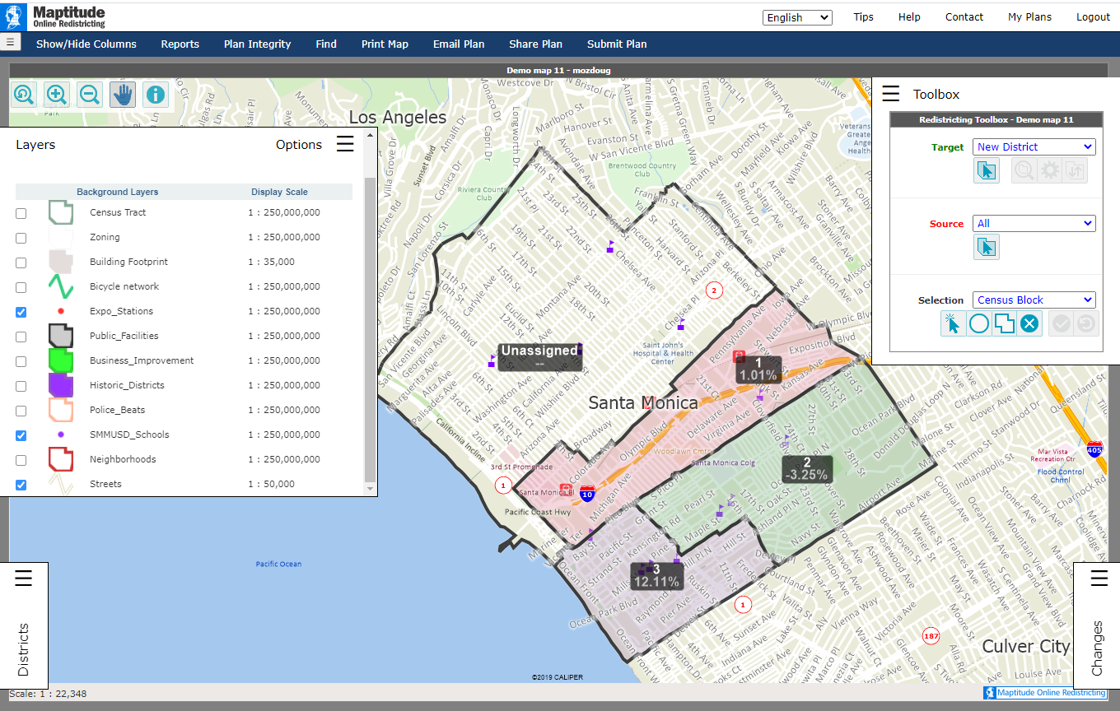
Caliper’s “Maptitude Online Redistricting”
Full Database, Powerful Online Mapping Tool
Powerful, common, data-rich online tool
Six language options: English, Spanish, Portuguese, Vietnamese, Mandarin and Korean
Quick Start Guide

Slide 15
Advisory Commission?
Greater objectivity without self-interest
Commissioners reach out to their networks
Less intimidating atmosphere, more open discussion
Commission instead of Council identifies “communities of interest”
Commission refines draft maps, narrows to 2-3 maps, instead of taking time during a council meeting

Slide 16
Advisory Commission?
Meetings are less accessible, often scheduled on the same days as school boards, planning commission, library board, other commissions and committees
Public unaware of the commission and have the expectation to participate at council meetings during the pre-map and map drawing phase
Requires public education campaign regarding the new commission and when, where, and how to participate
Staff resources to establish and administer a new commission—separate record keeping system, noticing, website page and postings, agenda, minutes, oaths of office, conflict of interest filings, Brown Act compliance, AB1234 ethics training, public record act requests, responding to commissioners’ questions and inquiries.

Slide 17
Advisory Commission?
Staff resources to set up and staff meetings including meeting site prep, sound systems, audio recording, and minutes. Possible overtime for approximately two additional meetings per month.
Census delay creates a time crunch. State prisoner-adjusted counts will be available in early October, then a three-week waiting period before staff or consultant can produce maps, then commission meets usually at least twice before choosing focus maps to present to council. The crunch is accentuated because of November and December holiday schedules.

Slide 18
…or City Staff?
Step | Description
Two Initial Hearings June 21 & August 2 | Held prior to release of draft maps. Education and to solicit input on the communities in the Districts.
Census Data Release Mid/Late August | Census Bureau releases official 2020 Census population data.
California Data Release Early October 2021 | California Statewide Database releases California’s official ‘prisoner-adjusted’ 2020 redistricting data.
Public Workshops January 22 | Two separate mapping tools workshops – morning and afternoon. (Additional workshops, based on demand.)
Two Draft Map Hearings February 7 & March 7 | Two Public Hearings to discuss and revise the draft maps and to discuss the election sequence.
Map Adoption By April 17, 2022 | Final map must be posted at least 7 days prior to adoption. Map adopted via ordinance.*

Slide 19
Public Hearing & Discussion
Advisory Commission or City Staff?
What is your neighborhood and what are its boundaries?
What other notable areas are in the City, and what are their boundaries?
Any questions about the mapping tools?
SECOND PUBLIC HEARING (August 2)
Discussion, then Action:
Vote on areas that meet each AB 849 definition:
“neighborhoods”
“communities of interest . . . that should be included within a single district for purposes of its effective and fair representation.”

